Slide 1
CSE 471 - Lab 01
Requirement Analysis

Slide 2
Requirement
What a system must do (Functional)
Characteristics the system needs to have (Non-Functional)
FOR CSE471 Lab Project, Only Functional Requirements are required.
Analysis Phase
Requirements are described from business perspective
Detailed version of “Business Requirements” from System Request
Later, turned into technical requirements

Slide 3
Functional Requirement
Business users need to perform a task
Process, system must perform
Information, system should contain
Example: EMR Management System
Business Requirement -> Patients can schedule appointments online
Functional Requirement -> ?

Slide 4
Functional Requirement
Business users need to perform a task
Process, system must perform
Information, system should contain
Example: EMR Management System
Business Requirement -> Patients can schedule appointments online
Functional Requirement -> Process
Search doctors by
specializations,
organizations,
years of experience

Slide 5
Functional Requirement
Business users need to perform a task
Process, system must perform
Information, system should contain
Example: EMR Management System
Business Requirement -> Patients can schedule appointments online
Functional Requirement -> Information
Retain previous appointment history - upto 3 months

Slide 6
Non-Functional Requirements
Characteristics, system should have
Operational
Performance
Security
Cultural & Political
Example:
EMR Management System -> ?

Slide 7
Non-Functional Requirements
Characteristics, system should have
Example:
EMR Management System ->
Operational -> Mobile devices, IE9
  Performance -> Patient data import takes < 2 seconds
  Security -> Only doctors can view patient test results
  Cultural & Political -> Data centers located in BD

Slide 8
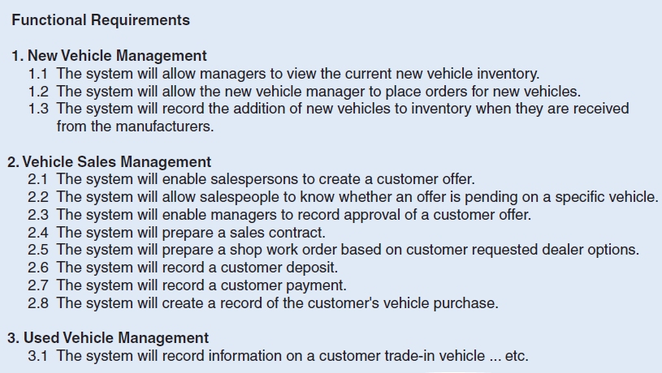
Format

Slide 9
Format
Functional:
Place online appointment
1.1
1.2
Non-Functional:
Operational :
1.1
1.2
Performance :
Security :
Cultural & Political :

